Slide 1
High Energy Astrophysics and Cosmology Technology Investment across NASA Astrophysics pcos.gsfc.nasa.gov
Ann Hornschemeier
Physics of the Cosmos (PCOS) Program, Chief Scientist
Notes:
Purpose is to give some idea of investments in technology in high energy astrophysics across NASA astrophysics. The title in the program says SAT and APRA. MY focus is on the SAT program, which is within the Physics of the Cosmos program, however I’ll highlight other ways technology is funded outside PCOS, including APRA projects.

Slide 2
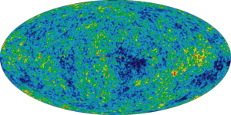
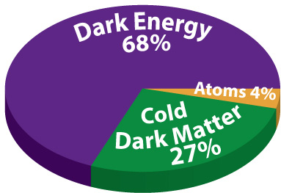
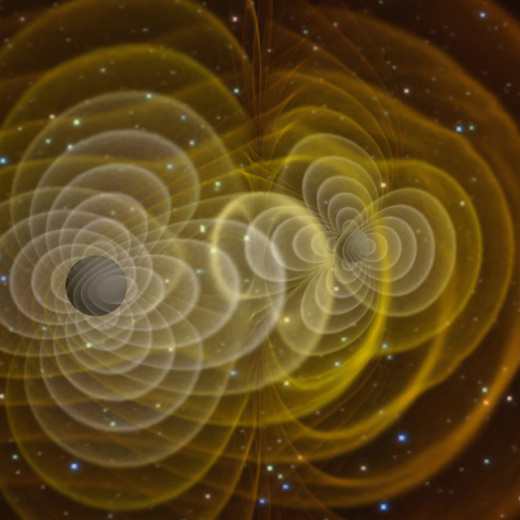
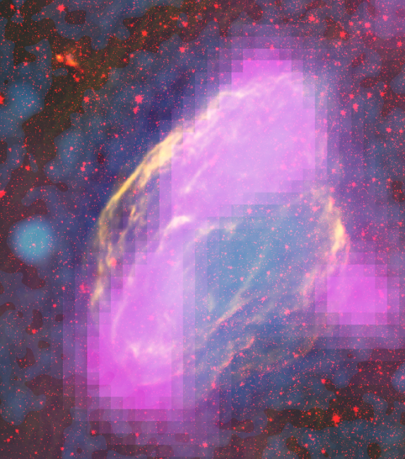
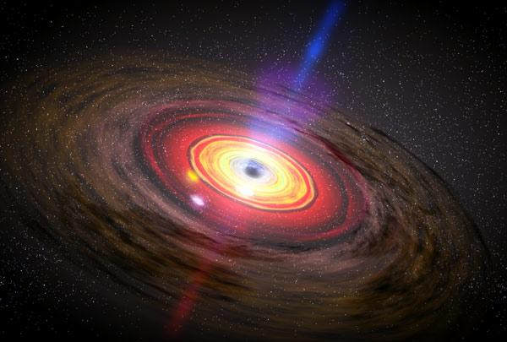
Physics of the Cosmos Science Objectives
Expand our knowledge of dark energy
Precisely measure the cosmological parameters governing the evolution of the universe and test the inflation hypothesis of the Big Bang
Test the validity of Einstein's General Theory of Relativity and investigate the nature of spacetime
Understand the formation and growth of massive black holes and their role in the evolution of galaxies
W44 SNR
Explore the behavior of matter and energy in its most extreme environments

Slide 3
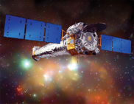
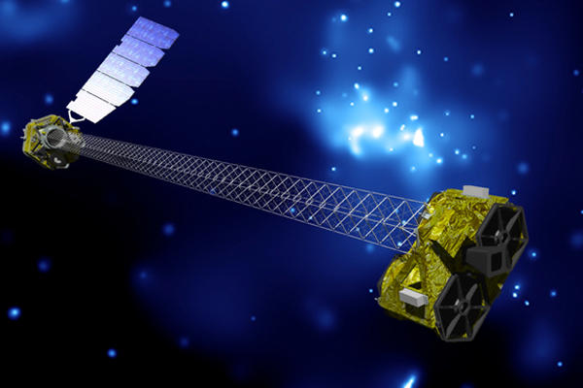
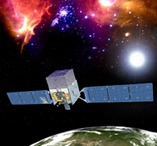
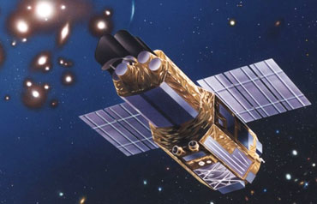
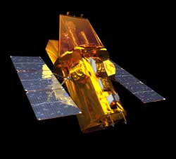
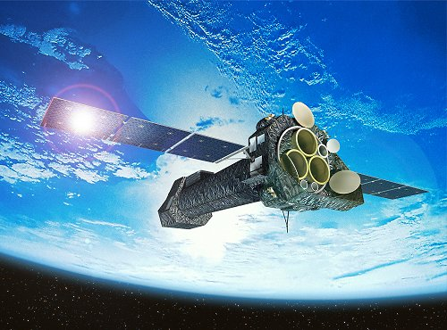
PCOS MISSIONS
OPERATING RELATED
Chandra
NuSTAR
Suzaku
Fermi
Swift
XMM

Slide 4
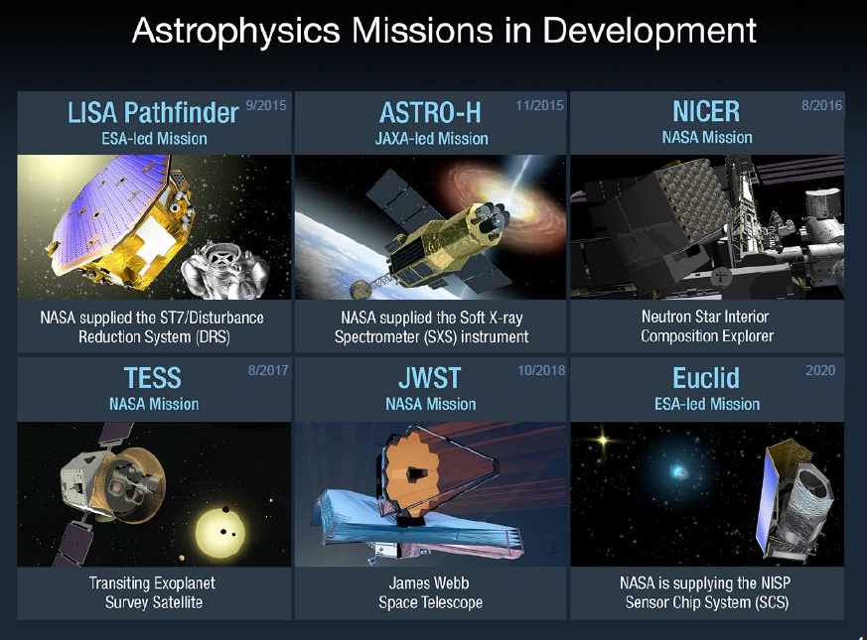

Slide 5

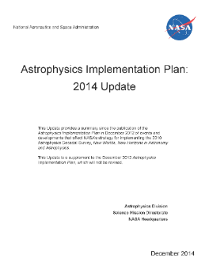
Physics of the Cosmos (PCOS): Scientific and Technical Stewardship for future missions
Provide scientific and technical stewardship for decadal-survey recommended missions:
Of the six highly-ranked medium and large-scale space-based priorities in NWNH, three fall within the PCOS science program:
LISA (Gravitational Waves)
IXO (X-ray)
Inflation Probe (medium-scale)
NOTE: Although dark energy SCIENCE is within PCOS program, WFIRST is located within the Exoplanet Program
NEW
Notes:
NOTE THAT HALF OF ALL THE MEDIUM AND LARGE SCALE SPACE PRIORITIES FALL WITHIN THE PCOS PORTFOLIO.

Slide 6
ROSES 2014, Priorities for the PCOS Strategic Astrophysics Technology (SAT):
The following technological areas are identified as of particular interest for the TPCOS Program:
• Technologies for X-ray Astrophysics, including, but not limited to, high-resolution microcalorimeter arrays, lightweight replicated optics and precision structures, high-resolution gratings (both transmission and reflection).
• Technologies for Gravitational Wave Astrophysics, including, but not limited to: dimensionally stable, optical telescopes; frequency-stabilized metrology lasers; high-resolution phasemeters; low-noise microthrusters; ultra-quiet inertial references; and long-distance, laser metrology techniques.
• Technologies for CMB Polarization Measurements, including, but not limited to, high-throughput cold mm-wave telescopes and large low-background multiplexed arrays of detectors.

Slide 7
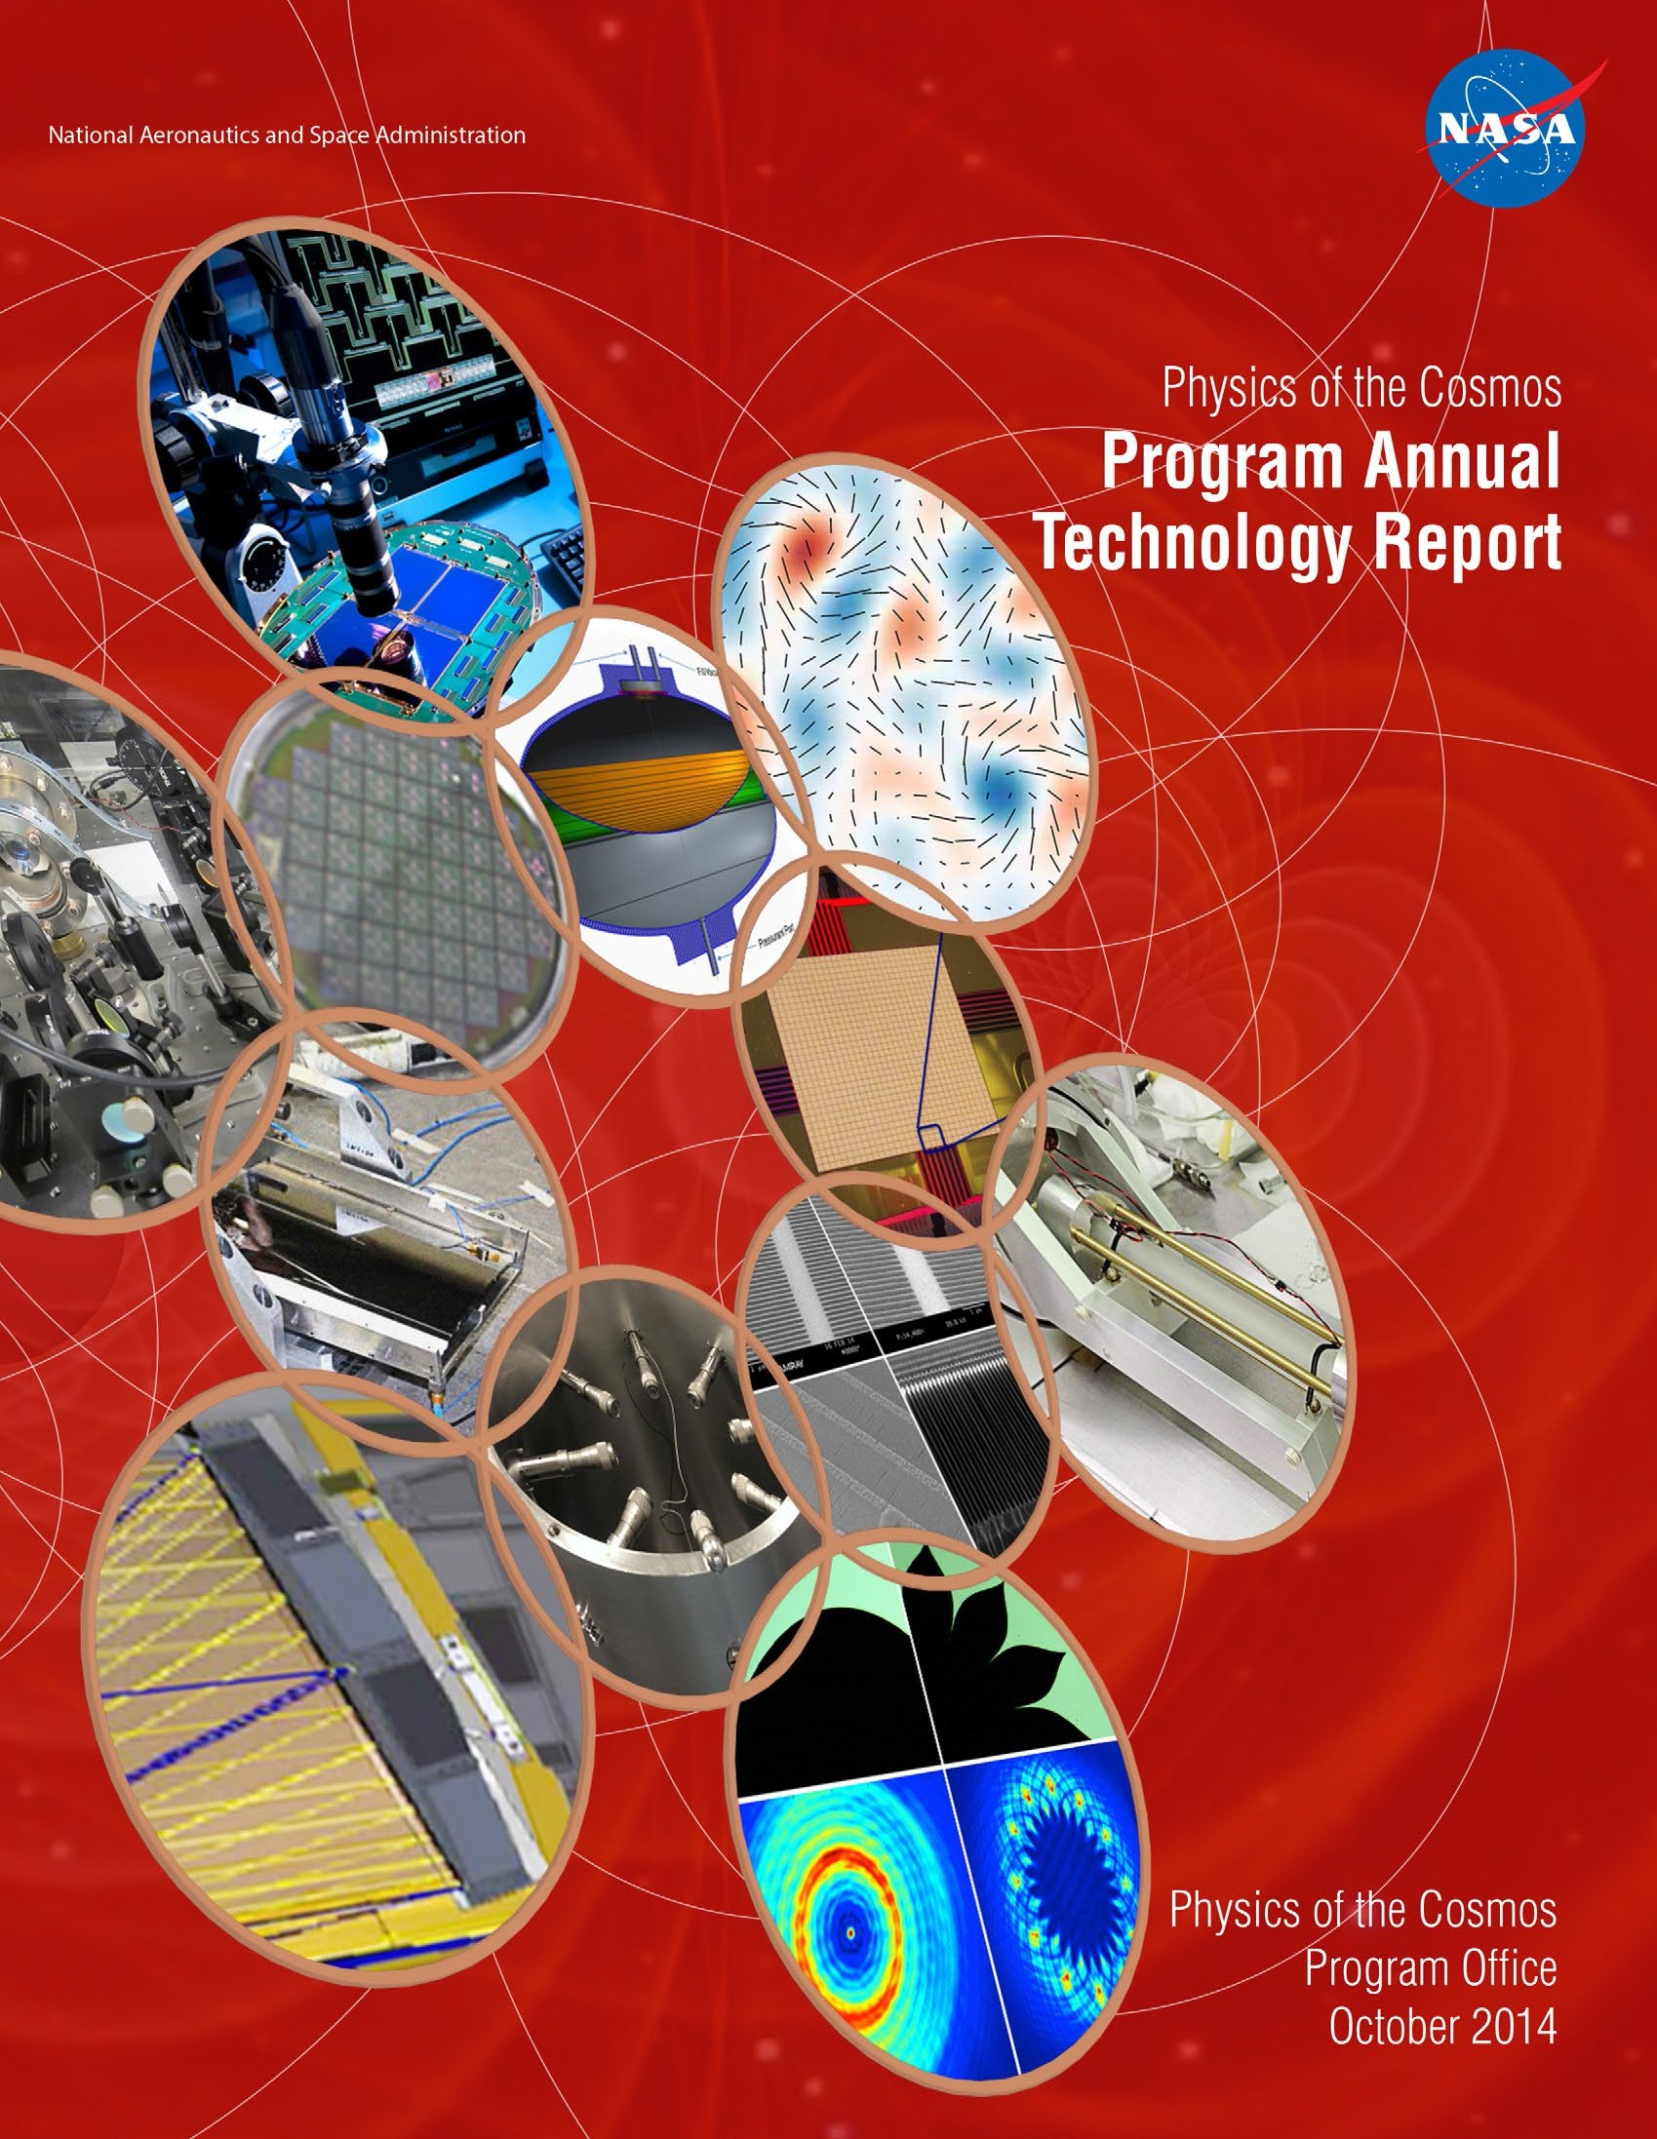
Technology development within the PCOS portfolio
For a summary each year, please read the PCOS Program Annual Technology Report (PATR)
Includes:
Progress report on all funded PCOS SAT activities
Technology priorities for PCOS

Slide 8
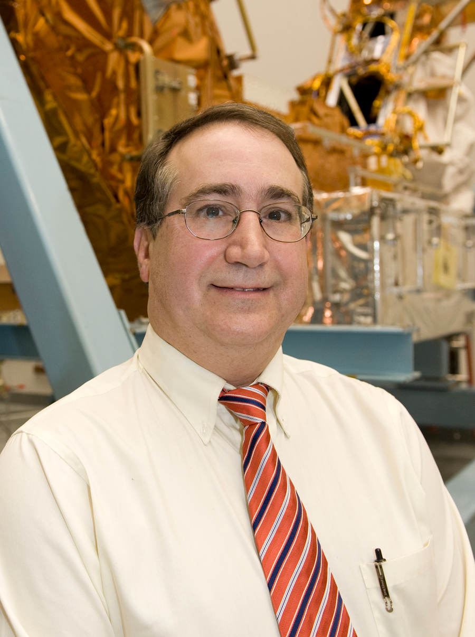
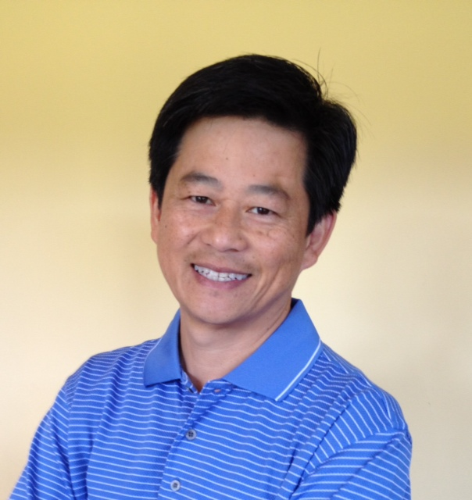
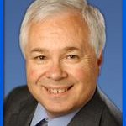
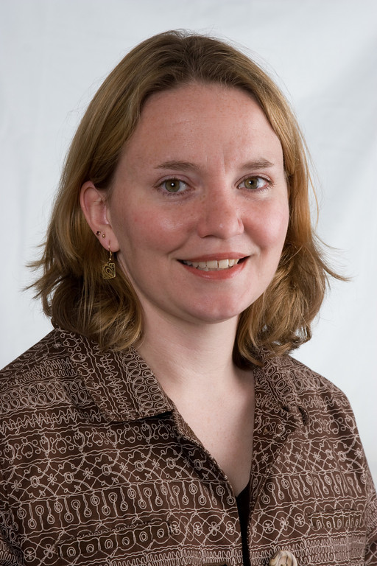
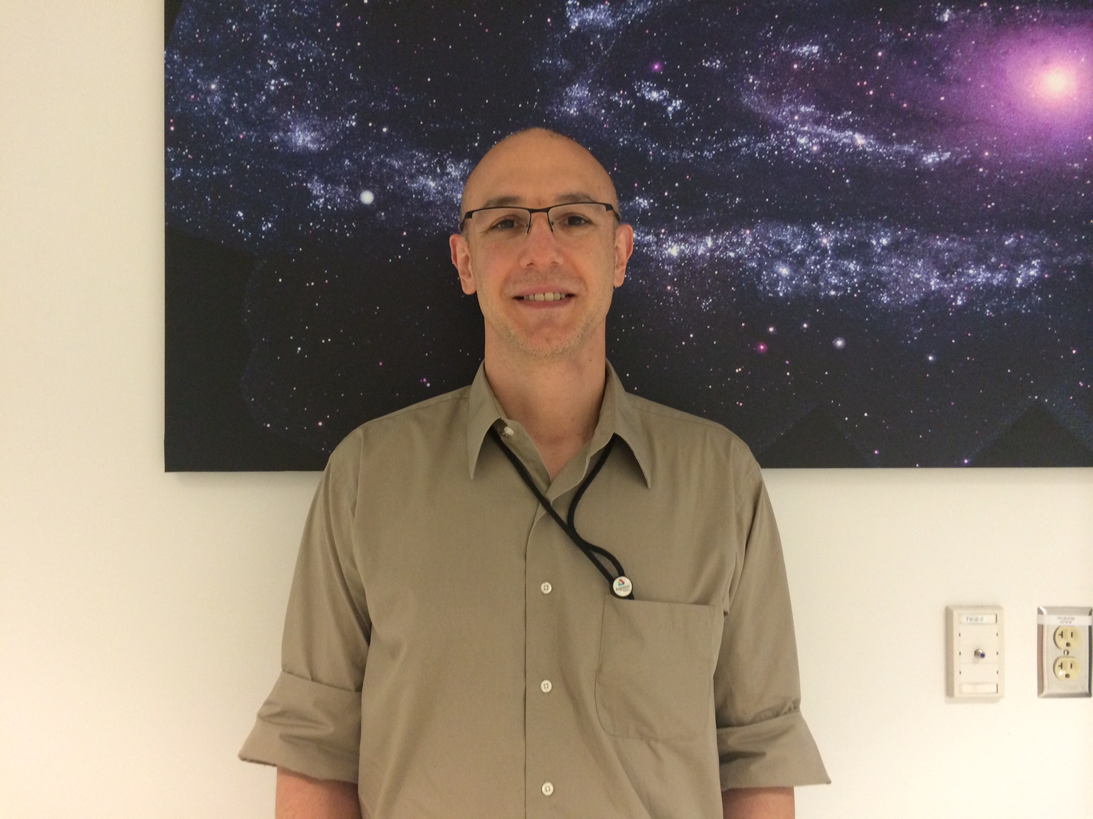
PCOS Program Office Leadership
MOONI
** Program Manager: Mansoor Ahmed (a.k.a. Mooni)
** Deputy PM: Tom Griffin
Chief Scientist: Ann Hornschemeier
Deputy Chief Scientist: Peter Bertone
**Chief Technologist: Bernard Seery
**Technology Development Manager: Thai Pham
** = Shared with COR, Cosmic Origins
TOM
THAI
BERNARD
ANN
PETER

Slide 9
The Strategic Astrophysics Technology (SAT) program
In 2009, the Astrophysics Division launched the Strategic Astrophysics Technology (SAT) program to support the maturation of technologies of mid-range TRL already developed and tested in the laboratory (TRL~3) to a point where they can be incorporated into a flight mission with an acceptable level of risk (typically TRL 5 or 6).
The SAT program does not support:
basic research of new technologies (TRL< 3)
Flight qualification of mature technologies (TRL 7-9).
SAT fills the so-called “Mid-TRL Gap” of technologies that have potential but are not sufficiently mature for adoption in flight programs

Slide 10
Five years of Strategic Astrophysics Technology (SAT) SELECTIONS
SAT Element | 2009 | 2010 | 2011 | 2012 | 2013* | 2014
TDEM | 7 (20%) | 9 (40%) | … | 3 (18%) | 4 (40%) | Pending
TCOR | … | 3 (21%) | 5 (21%) | 3 (23%) | … | Pending
TPCOS | … | 5 (23%) | 5 (19%) | 3 (30%) | 6 (75%) | Pending
TOTAL: | 7 | 17 | 10 | 9 | 10 | Pending
71 PCOS SAT proposals to date, 19/65 funded (29%)
*X-ray solicitation only, potential technologies that might be
contributed to ESA’S Athena mission
Notes:
SAT Element TDEM/SAT 2009 SAT 2010 SAT 2011 SAT 2012
TDEM 7 9 Not solicited 3*
TCOR _ 3 5 3
TPCOS _ 5 5 3
TOTAL
7 17 10 9

Slide 11
PCOS SAT Funding
Fiscal Year | TOTAL PCOS SAT
FY12 | $2,351K
FY13 | $8,328K
FY14 | $7,837K
FY15 | $6,012K
FY16 | Pending
Notes:
FY12- $2,351K FY13 - $8,328K FY14 $7,837K FY15 - $6,012K FY16 - Pending

Slide 12
Currently-funded PCOS SAT projects
14 currently-funded PCOS SAT projects:
7 finish this fiscal year
By topical area:
Gravitational waves: 5 (4 finish this FY)
X-ray: 8 (2 finish this FY)
Inflation Probe: 1 (finishing this FY)

Slide 13
Current PCOS Technology Development Portfolio

Slide 14

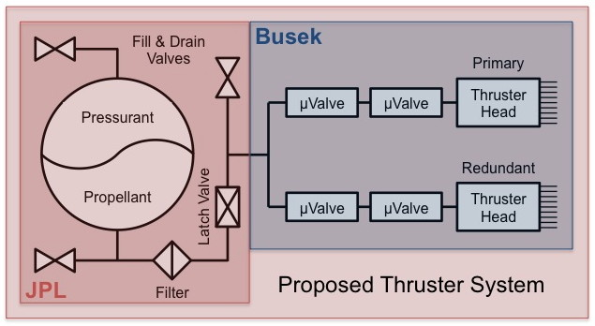
Colloid Microthruster Propellant Feed System
PI: John Ziemer/JPL
Objectives and Key Challenges:
Replace the heavy (up to 15 kg) spring-loaded bellows design from ST7 with a light-weight pressurized diaphragm tank (≤1 kg)
O1: Design tank and feed system with full redundancy
O2: Design, fabricate, and test stainless steel diaphragm tank
Use the new Busek Microvalve (Phase II SBIR and Phase IIe) to reduce complexity while providing redundancy
O3: Design, fabricate, and test new Busek Microvalves
O4: Integrate and test feed system components to TRL 5
Significance of Work:
A new, flight-like, fully redundant, higher capacity colloid thruster feed system at TRL 5 can support any gravity wave observatory concept
A clear path to TRL 6 once the mission and system are defined
Approach:
Teaming arrangement between flight tank vendor Keystone, Busek for the Microvalve, and JPL to manage, perform I&T
Use standard liquid-fed propulsion flight design guidelines and practices – the new technology is in the assembled pieces working together, not the propulsion engineering approach
Four tasks related to each objective, plus a management task, each with a JPL expert lead
Hold peer reviews at each meaningful milestone: requirements definition, design, and test
Recent Accomplishments:
Tank fabrication and TRL 5 tests are complete
Microvalve fabrication and environmental tests are complete
Redundant Microvalve subassembly including accumulator and volume compensator has been fabricated and tested for TRL 5
Tank and supportive feed system components are all at JPL, ready for integration; data system complete
Next Milestones:
Receive Busek Microvalve subassembly and test full feed system assembly to TRL 5
Key Collaborators:
Busek Co., Inc. on Microvalve and systems engineering
Keystone Engineering on flight-like tank manufacture and test
JPL electric / chemical propulsion and flight propulsion groups
Application:
Drag-free gravity wave observatories
Remove reaction wheels - precision pointing of exo-planet observatory and next generation space telescopes
Small spacecraft main propulsion
Current Funded Period of Performance:
Jan 2013 – Jan 2015
TRLin = 3-4 TRLcurrent = 4 TRLtarget = 5
Notes:
Will show EXAMPLE quad chart, choosing John Ziemer’s program

Slide 15
Other PCOS and PCOS-related technology activities
LISA Pathfinder, IR arrays for dark energy, and some “PCOS APRA highlights”

Slide 16

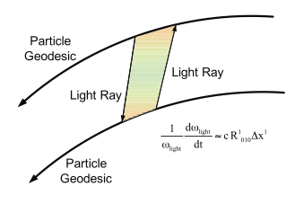
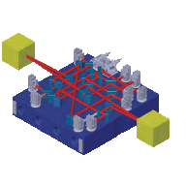
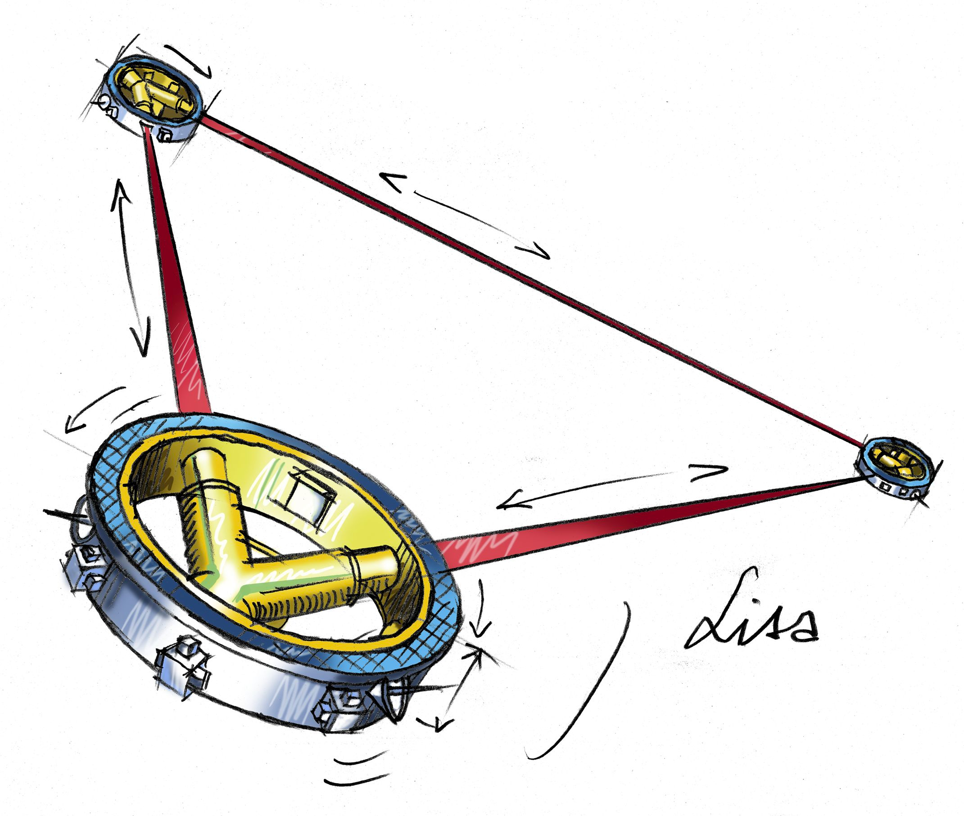
LISA Pathfinder
Goal: Demonstrate measurement concept an key technologies for a future space-based gravitational-wave observatory.
Textbook GW detector
LISA Mission Concept
Technology Demonstrator
Measurement Concept:
Interferometric ranging between two free-falling test masses.
Replicates single “arm” of a LISA constellation in one spacecraft.
Not sensitive to gravitational waves but very similar instrument noise

Slide 17
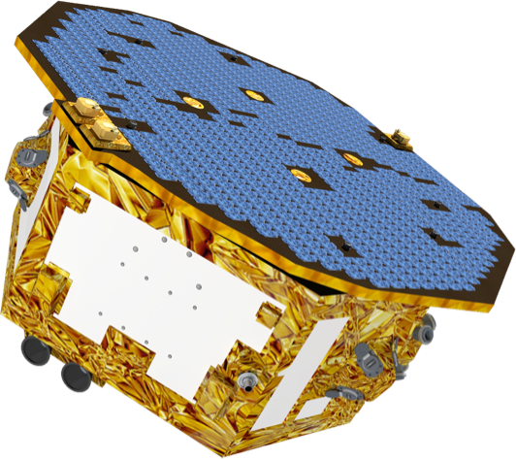
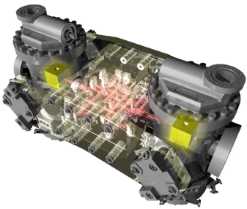
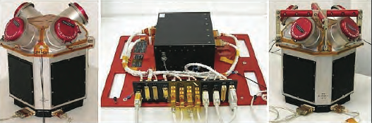
Key Components
Spacecraft
Provided by ESA
Industrial Prime Contractor: Airbus Defense & Space
Spacecraft also includes the drag free control software and micro-Newton thrusters
Payloads
The LISA Technology Package (LTP)
Provided by European member states and ESA
inertial sensors, interferometric readout, payload computer and diagnostic subsystem
The Disturbance Reduction System (DRS)
Provided by NASA (JPL lead, GSFC participation)
processor running drag-free control software and micro-Newton thrusters
Utilizes LTP sensors/actuators
LPF
LTP Core Assembly
ST7-DRS

Slide 18
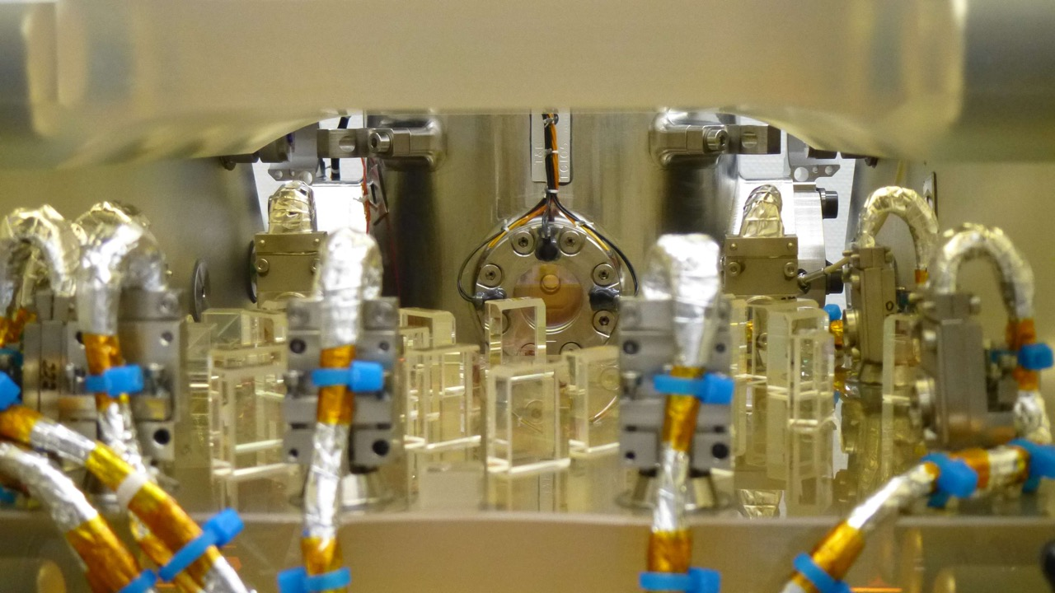
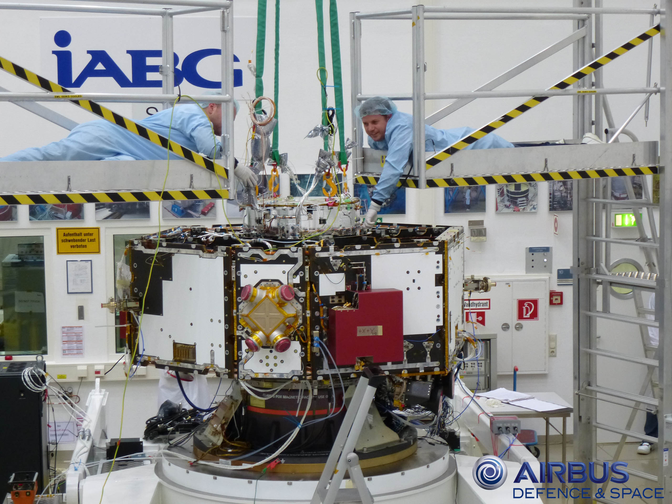
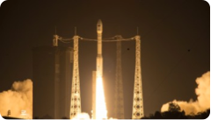
LISA Pathfinder Current Status
Spacecraft/Payload
ST7 delivered and accepted in 2011
LTP delivered and accepted in June 2015
Both payloads integrated with spacecraft in June 2015
Final SC testing underway
Shipment Readiness: Sept. 2015
Operations
Infrastructure complete and tested
Data analysis infrastructure nearing completion
Launcher (VEGA)
5 successful launches so far, LPF will be number 6
LPF’s eastward trajectory requires modification of launch profile.
Launcher readiness currently driving launch date estimated as November 2015.
LTP integration showing optical bench and gravitational reference sensor. (ESA, Airbus, CGS, U. Glasgow)
LTP being lowered into LPF spacecraft (ESA, Airbus)
VEGA launch of Sentinel 2A on June 22nd, 2015

Slide 19
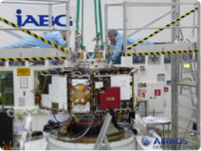
LISA Pathfinder Current Status
Spacecraft/Payload
ST7 delivered and accepted in 2011
LTP delivered and accepted in June 2015
Both payloads integrated with spacecraft in June 2015
Final SC testing underway
Shipment Readiness: Sept. 2015
Operations
Infrastructure complete and tested
Data analysis infrastructure nearing completion
Launcher (VEGA)
5 successful launches so far, LPF will be number 6
LPF’s eastward trajectory requires modification of launch profile.
Launcher readiness currently driving launch date estimated as November 2015.
LTP integration showing optical bench and gravitational reference sensor. (ESA, Airbus, CGS, U. Glasgow)
LTP being lowered into LPF spacecraft (ESA, Airbus)
VEGA launch of Sentinel 2A on June 22nd, 2015

Slide 20

Euclid A visible and near-infrared telescope to explore cosmic evolution
CURRENT STATUS:
Currently in implementation phase.
~50 U.S. scientists are members of the Euclid Science Team that will analyze the data, and make maps of the sky.
NASA is providing the sensor assembly for the NISP instrument.
First experimental manufacturing run for the Euclid near-infrared detectors was completed in FY 2014 (ESA) and are currently being evaluated and characterized.
NASA has initiated purchase of the flight infrared detectors. First lot is complete, second lot underway. NASA will test and characterize the near-IR flight detectors.
Final proposal for detector contract received from Teledyne in February 2015.
NASA is funding the ENSCI (Euclid NASA Science Center at IPAC):
Support all segments of US community on Euclid to enhance science utilization
Integrate into Euclid Science Ground System provided by the Euclid consortium to gain/contribute expertise in pipelines
ESA Cosmic Vision 2015-2025 Mission, M-Class with NASA participation.
1.2-m mirror, visible & near-IR images, spectra
Launch Date: Mar 2020
Science Objectives:
Euclid will look back 10 billion years into cosmic history.
Probe the history of cosmic expansion
Probe dark matter along the line of sight to galaxies via gravitational lensing, probing large scale structure.
Measure galaxy clustering
Notes:
Updated August 11, 2014

Slide 21
IR arrays for Dark Energy: H2RGs, H4RGs
The Teledyne H2RG is a 2048x2048 pixel sensor chip assembly (SCA) developed for JWST (PI: Prof. Don Hall, University of –Hawaii-). The H2 = “Hawaii-2” was an existing legacy detector, “R” = reference pixels, and “G” = built in “guide window”. The material is mercury-cadmium-telluride (HgCdTe)
The Teledyne H4RG-10 is a 4096x4096 pixel SCA that has 10 µm pixels. An optical version exists (TRL-6) and WFIRST is supporting development of an IR version of the H4RG.

Slide 22
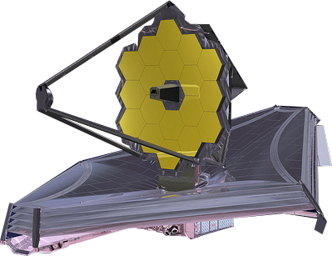
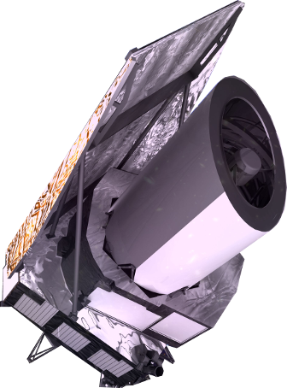

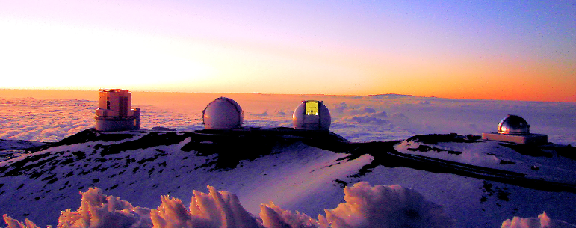
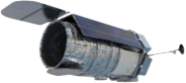
Today’s Near-IR Focal Plane Technology for Astrophysics
 | JWST | Euclid | WFIRST-AFTA (preformulation, 6/2015) | Ground Based Astronomy (GBA)
SCA | H2RG 15 Flight SCAs 8 with 2.5 µm cutoff HgCdTe 7 with 5 µm cutoff HgCdTe T ~ 40 K Moly package, TRL-8 | H2RG 16 Flight SCAs 2.3 µm cutoff HgCdTe T ~ 100 K Moly package, TRL-7 | H4RG-10 (and others) 18 Flight H4RG-10s for wide field imager Smaller format (legacy) HxRGs for IFU 2.5 µm cutoff HgCdTe in H4RG-10s T ~ 100 K | Various (this list is incomplete) Raytheon 4Kx4K pixel HgCdTe arrays in development 2Kx2K HgCdTe VISTA arrays in use Selex Galileo HgCdTe APD arrays used for wavefront sensing and guiding Teledyne 4Kx4K H4RG-15 in development 2Kx2K H2RG widely used
SCE | SIDECAR 15 flight SIDECARs (1 per SCA) T ~ 40 K TRL-8 | SIDECAR 16 flight SIDECARs T ~ 125 K TRL-6/7 | SIDECAR One SIDECAR per flight SCA T ~ 175 K | Various Custom, observatory-specific controllers often used Commercial “Leach” controllers popular SIDECAR sometimes used, but GBA does not face the same packaging and power constraints as space
Credit: Bernie Rauscher, Ed Cheng, Neil Gehrels, Bob Hill
Notes:
Sensor chip electronics (SCE) provide bias voltages, clocking waveforms, and ADC conversion for the SCA. Teledyne’s SIDECAR ASIC is an ultra-compact implementation that is suitable for cryogenic applications. On the ground, “IR Array Controller” boxes perform much the same function. The ground based controllers typically offer somewhat better performance but at high cost in mass, power, and volume. Lab controllers cannot run at cryogenic temperatures.

Slide 23
ASTROPHYSICS RESEARCH AND ANALYSIS PROGRAM (APRA)
Five broad categories:
Suborbital/Suborbital-class Investigations ($5-6M per year)
Detector Development ($1-3M per year)
Supporting Technology ($2-4M per year)
Laboratory Astrophysics ($0.6-2M per year)
Ground-Based Observations ($30-60K some years).
Covers technology development from TRL1→ TRL9
Note also that ROSES also has a solicitation for XRP – Exoplanet Research Program – proposals outside of APRA.

Slide 24
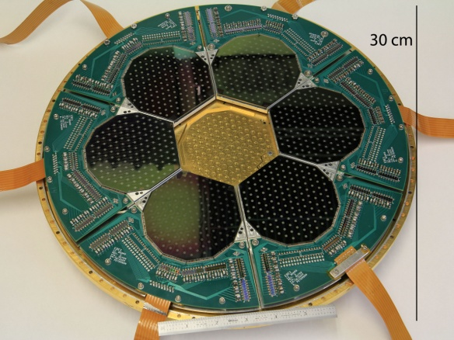
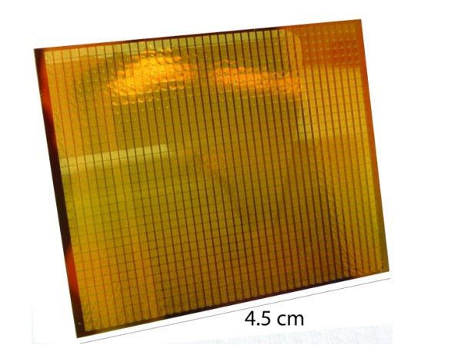
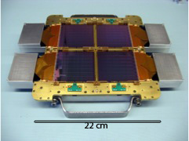
CMB Polarization from Space, Balloons
Note: APRA balloon experiments are “outside PCOS” programmatically.
Currently NASA supports three balloon-borne experiments that probe the polarization properties of the CMB covering 90-600 GHz with Transition-Edge (TES) bolometers with different polarimetric approaches :
EBEX2012: (2012-2015): Flight in Jan 2013, E and B experiment (EBEX; P.I. Hanany), intermediate ell, analysis underway and paper anticipated by end of 2015
SPIDER: (2012-2016): Recent flight in 2014 Dec-Jan: Suborbital Polarimeter for Inflation Dust and the Epoch of Reionization (P.I. Bill Jones)
PIPER Phase 3 (2015-2019): Primordial Inflation Polarization Explorer Phase 3 (P.I. Al Kogut)
EBEX
Notes:
SPIDER would have flown in 2013 but there was a government shutdown
probing a broad range of frequencies between 90 and 600 GHz with overlapping frequencies: 90–220 GHz for SPIDER, 150–410 for EBEX, and 200–600 GHz for PIPER
TOP: for its flight launched in 12/2012 EBEX used two focal planes, each with seven wafers (dark decagons) and 140 bolometers/wafer (white dots). (The central wafer is missing in this photograph.) Center: One of the six focal planes that will be used by SPIDER in the upcoming 12/2014 flight. This focal plane has 512 polarization sensitive bolometers. Right: Focal plane for the PIPER experiment containing 1280 bolometer. Each flight will use 4 such focal planes (PIPER in 2015, if funded)

Slide 25
Most recent suborbital APRA selections (APRA-2013)
There were 8 payloads selected last year, 5 of these are PCOS-related**:
SuperTIGER-2: A Very-Large-Area, High-Resolution Trans-Iron Cosmic Ray Investigation (Walter Binns)
A Balloon-Borne, Advanced Scintillator Compton Telescope with Silicon Photomultiplier Readout (Peter Bloser)
Diffuse X-rays from the Local galaxy (DXL) (Massimilliano Galeazzi)
Primordial Inflation Polarization Explorer (Phase 3) (Al Kogut)
Ultra-high Energy Particle Astrophysics with ANITA-4 (Peter Gorham)
*** = PCOS science, APRA does not sort by program!
Notes:
Binns, Walter Bloser, Peter Galeazzi, Massimiliano Kogut, Alan Gorham, Peter

Slide 26
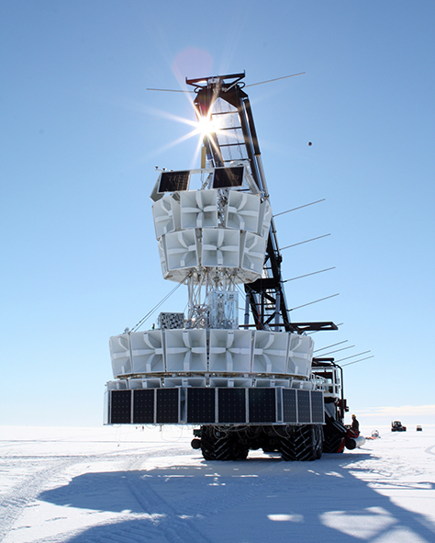
ANITA (Antarctic Impulsive Transient Antenna) Long-Duration Balloon Payload
Most sensitive neutrino observatory in the world at 1-100 EeV energies (1 EeV = 1e9 GeV = 1000 PeV)
Complements the “low energy” IceCube experiment
Detects UHECRs via radio synchrotron from air showers
Detects UHE neutrinos by recording broadband radio pulses from particle showers produced by neutrino interactions in Antarctic ice
P.I., Gorham, University of Hawaii at Manoa
Co-Is:
James Beatty/Ohio State University
Dave Besson/University of Kansas
Walter Binns/Washington University in St. Louis
John Clem/University of Delaware
Andrew Romero-Wolf/Jet Propulsion Laboratory
Notes:
ANITA detects UHECRs by detecting the radio synchrotron emission from air showers resulting from UHECRs interacting in the earth’s atmosphere.

Slide 27
How can you interact with NASA’s Physics of the Cosmos program?

Slide 28
Communicating with NASA Astrophysics via the Program Analysis Groups (PAGs)
The Physics of the Cosmos Program Analysis Group (PhysPAG) serves as a forum for soliciting and coordinating input and analysis from the scientific community in support of the PCOS program objectives.
The Program Analysis Groups (PAGs) include all members of the community interested in providing input to NASA on issues of strategic importance via analysis studies
PAGs hold regular public meetings.
PAGs identify specific, well-defined topics for further detailed studies assigned to Study Analysis Groups (SAGs) as well as longer-standing, discipline-centered analysis groups – Science Interest Groups (SIGs). All are task forces of volunteers.
Advisory Committees
NASA Advisory Committee (NAC)
Science
Committee
Astrophysics Subcommittee
ExoPAG
PhysPAG
COPAG

Slide 29
PhysPAG SIG Leaders
Six Science Interest Groups: Cosmic Structure, Inflation Probe, Gamma Rays, Cosmic Rays, Gravitational Waves, X-Rays, Cosmic Structure (NEW! March 2015)
PhysPAG Executive Committee membership:
J. Bock, Chair, California Institute of Technology
M. Bautz, Vice-Chair, MIT, X-rays
R. Bean, Cornell University, Cosmic Structure
J. Bookbinder, SAO, X-Rays
J. Conklin, University of Florida, Gravitational Waves
N. Cornish, Montana State, Gravitational Waves
O. Doré, NASA Jet Propulsion Laboratory, Cosmic Structure
H. Krawczynski, Washington University St. Louis, Gamma Rays
M. McConnell, University New Hampshire, Gamma Rays
A. Miller, Columbia University, Inflation
J. Nousek, Penn State, X-Rays
A. Olinto, University of Chicago, Cosmic Rays
Eun-Suk Seo, University of Maryland, Cosmic Rays
E. Wollack, NASA Goddard Space Flight Center, Inflation
Rotating off in Dec 2015, Call for applications in Fall 2015

Slide 30
Technology gaps for the PCOS program: informing the rankings in the PCOS PATR
2014:
The PCOS Program Office (PO) received 21 gaps for consideration by the 2014 TMB, and forwarded all of these to the PCOS Technology Management Board
The TMB folded seven of the gaps into others, leaving 14 for prioritization.
2015:
The PCOS Program Office (PO) received 37 gaps for consideration by the 2015 TMB
These were forwarded to the PhysPAG EC for consolidation, underway NOW

Slide 31
THANK YOU
Ann.Hornschemeier@nasa.gov
pcos.gsfc.nasa.gov
(Sign up for email list at “PCOS News and Announcements tab)

Slide 32
Back-UP Charts

Slide 33
Five years of Strategic Astrophysics Technology (SAT) Proposals
SAT Element | 2009 | 2010 | 2011 | 2012 | 2013* | 2014
TDEM | 34 | 22 | … | 17 | 10 | 7
TCOR | … | 14 | 24 | 13 | … | 15
TPCOS | … | 21 | 26 | 10 | 8 | 6
TOTAL: | 34 | 57 | 50 | 40 | 18 | 28
*X-ray solicitation only, potential technologies that might be
contributed to ESA’S Athena mission

Slide 34
APRA Funding and Proposals Source: ROSES 2015 – APRA AO
APRA Category | Total allocated to new selections [$M] |  |  |  | Number of New Selections (including Co-I proposals)
 | A-09 | A-10 | A-11 | A-12 | A-09 | A-10 | A-11 | A-12
 | FY11 | FY12 | FY13 | FY14 | FY11 | FY12 | FY13 | FY14
Suborbital Investigations | 5.6 | 8.9 | 5.0 | 6.1 | 10 | 12 | 8 | 15
Detector Development | 1.9 | 1.3 | 2.7 | 3.1 | 6 | 4 | 10 | 7
Supporting Tech. | 4.3 | 2.8 | 3.1 | 1.9 | 15 | 12 | 13 | 6
Lab. Astro. | 1.0 | 1.8 | 0.9 | 0.6 | 8 | 8 | 8 | 5
Ground-based Obs. | 0.03 | 0.06 | 0 | 0 | 1 | 1 | 0 | 0
Notes:
APRA Category Total allocated to new selections [$M] Number of New Selections (includes Co-I proposals)
A-09 A-10 A-11 A-12 A-09 A-10 A-11 A-12
Suborbital Investigations 5.6 8.9 5.0 6.1 10 12 8 15
Detector Development 1.9 1.3 2.7 3.1 6 4 10 7
Supporting Technology 4.3 2.8 3.1 1.9 15 12 13 6
Laboratory Astrophysics 1.0 1.8 0.9 0.6 8 8 8 5
Ground-Based Observations 0.03 0.06 0 0 1 1 0 0

Slide 35
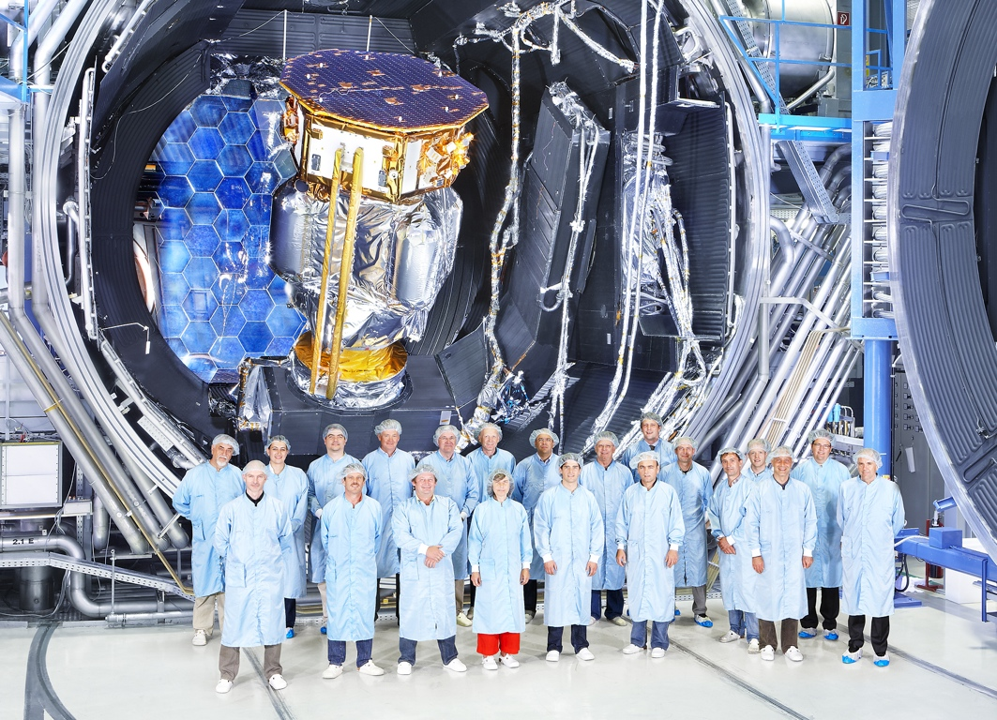
LISA Pathfinder Status (including JPL project ST7)
LPF Current Status: Late stages of integration with launch expected in October 2015.
Preparations for mission and science operations underway with numerous exercises/test campaigns planned for the coming year
ESA
Transfer Orbit Thermal Test

Slide 36

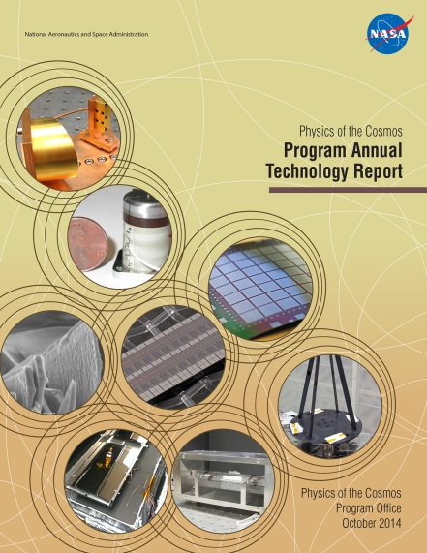
PCOS community activities
Encourage your finishing students and early-career postdocs to apply for the Einstein fellows’ program
Einstein Fellows hold their appointments at a Host Institution in the U.S. for research that is broadly related to the science goals of the NASA Physics of the Cosmos program.
The PhysPAG provides input on technology needs to the PCOS program office that are fed into the PCOS Annual Technology Report (PATR) each year. (Thanks for sending in 21 technology gaps during summer 2014!)
Laura Blecha, 2012 Fellow

Slide 37
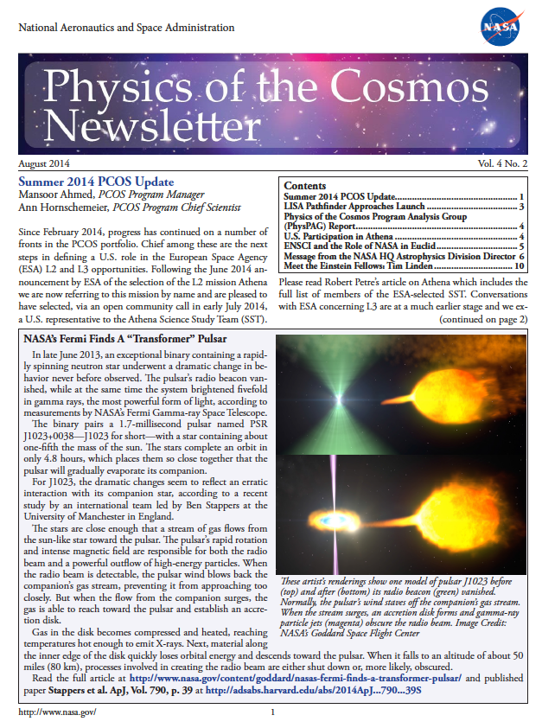
Keeping up with PCOS
Sign up for email announcements, or for a Science Interest Group
pcos.gsfc.nasa.gov

Slide 38
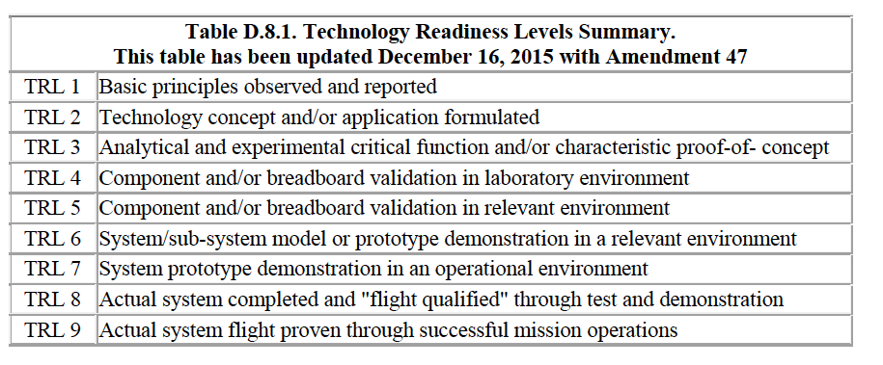
Technology Readiness Levels (TRL)
Taken from ROSES-2014 SAT call (proposals due March 2015)

Slide 39
Programs within Astrophysics@NASA Prioritization from Astro2010 Decadal Report
Astro2010 science themes map to the Astrophysics Division themes:
New Worlds Exoplanet Exploration
Cosmic Dawn Cosmic Origins
Physics of the Universe Physics of the Cosmos
The highest priority science for Physics of the Universe are captured in the PCOS Science Objectives:
Dark Energy: Probe the nature of dark energy by studying the expansion rate of the universe and the growth of structure
Theory of Inflation: Test the theory of inflation by measuring the polarization of the Cosmic Microwave Background.
Black Holes & General Relativity: Probe the properties of black holes and testing General Relativity using x-ray emission and gravitational waves.

Slide 40
ESA’s L2 Advanced X-ray Observatory: Athena (Launch: 2028)
Mission now in Phase A study in Europe with “Invitation to Tender” issued for industry bids for mission assessment.
First part of mission assessment looked at impact of smaller mirror area, involved many U.S. scientists
NASA and ESA are discussing a potential NASA contribution.
ESA Athena Science Study Team: Randall Smith (CfA) is U.S. member. Robert Petre (GSFC) and Michael Garcia (HQ) are ex officio.
ESA instrument AO expected mid-2016
NASA’s budget supports a potential Athena partnership.
NASA will continue investing in technologies likely to be appropriate for an Athena contribution including competed SAT investigations.
NASA is budgeting for flight hardware, U.S. participation in the Athena science team, and a U.S. data center and GO program.
NASA has suggested the following types of contributions, limited to $100-150M for contributed flight hardware.
Portions of the calorimeter instrument (US & Japan have entered X-IFU consortium)
Other possible contributions also under discussion
Notes:
The Athena Science Study Team has recently completed a study of the science impact of a reduction in the 1 keV mirror area from ~2m^2 to ~1.4m^2, which was suggested as a possible way to meet the ESA mission cost cap. This study was done with the active assistance of the Athena Science Working Groups, including many US astronomers, and concluded that most of mission science could be achieved at the cost of ~2 additional years of observing. The United States and Japan have recently joined the X-IFU consortium, bringing in teams currently involved in ASTRO-H. The prime contribution from NASA is expected to be the TES front-end science array of the X-IFU, through a GSFC/NIST/Stanford team led by Richard Kelley (GSFC). This contribution was determined based on a NASA issued RFI seeking possible US contributions to the Athena instrumentation. Other potential NASA contributions are still under active discussion with ESA, and discussions with the WFI consortium are underway as well. More information about the Athena mission and timeline is available at the website http://sci.esa. int/cosmic-vision/54517-athena/.

Slide 41
Future Gravitational Wave Observatory (Launch 2030’s)
NASA and ESA are discussing a potential NASA contribution to ESA L3 which has the theme “The Gravitational Universe”
NASA is participating in ESA’s planned assessments for its L3 gravitational wave observatory via the Gravitational Observatory Advisory Team (GOAT): www.cosmos.esa.int/web/goat
Interim report indicating laser interferometry is the recommended mission approach (per Arvind Parmar, ESA)
The partnership likely will be subject to Astro2020 decadal approval

Slide 42
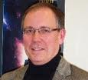
Deposited Blocking Filters for X-ray Detectors
PI: Mark Bautz/MIT MKI
Objectives and Key Challenges:
Silicon Imaging X-ray detectors require filters to block noise/background from UV and optical light
Filters must be thin (<300 nm) to transmit X-rays
State-of-the-art, free-standing filters use fragile, thin substrates
Objective: deposit blocking filter directly on CCD X-ray detector, eliminating substrate
Excellent Resolution
of CCD with Deposited OBF
Significance of Work:
Filter deposited on detector requires no fragile substrate
Allows cheaper, more robust sensors (no vacuum housing!)
Improves QE & makes larger focal planes practical
Challenges:
Deposit filter directly without compromising CCD performance
Deposit sufficiently thin, uniform filters
Approach:
Exploit existing stocks of (engineering grade/flight spare) X-ray CCD detectors at MIT Lincoln Laboratory
Screen, thin, passivate, package & apply filters to detectors
Filter is Al with AlO₂ cap
Start thick (220 nm Al), get progressively thinner
Use existing MIT facilities for X-ray characterization
Use existing & upgraded facilities for optical characterization
Recent Accomplishments:
Tested devices with alternative back side treatment (10nm MBE vs. 20nm MBE of previous) and 70nm & 100nm thick Al OBF. Optical blocking as expected; OD7 pinhole fraction 0.5%; X-ray performance similar to 20nm MBE devices
Identified leakage paths through CCD support wafer at long (λ≳1000nm) wavelength, with detection efficiency ~2.5%
Significant for REXIS (large visible-light flux)
Developed underside coating as countermeasures for leakage:
Aluminum or ‘Z307’ paint; REXIS will fly 1 of these
Key Collaborators:
MIT Kavli Institute (Bautz, Kissel et al.)
MIT Lincoln Laboratory (Suntharalingam, Ryu, Burke, O’Brien)
Next Milestones:
Support tests of REXIS flight CCDs/OBFs, achieve TRL-6
Application:
Every X-ray imaging or grating spectroscopy mission
Explorers (Lobster, Arcus…)
“Probes” (AEGIS, N_XGS, AXSIO, WFXT…)
Flagship (Athena...)
Current Funded Period of Performance:
Jul 1, 2012 – Dec 31, 2015
TRLin = 5 TRLcurrent = 5 TRLtarget = 5

Slide 43
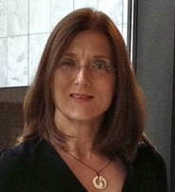
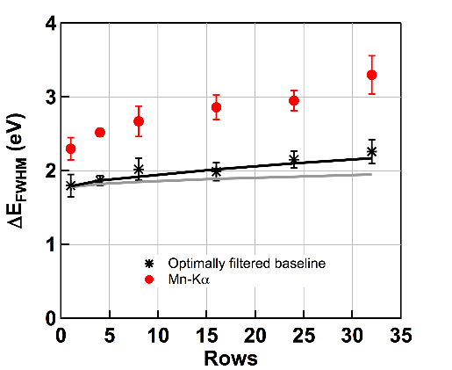
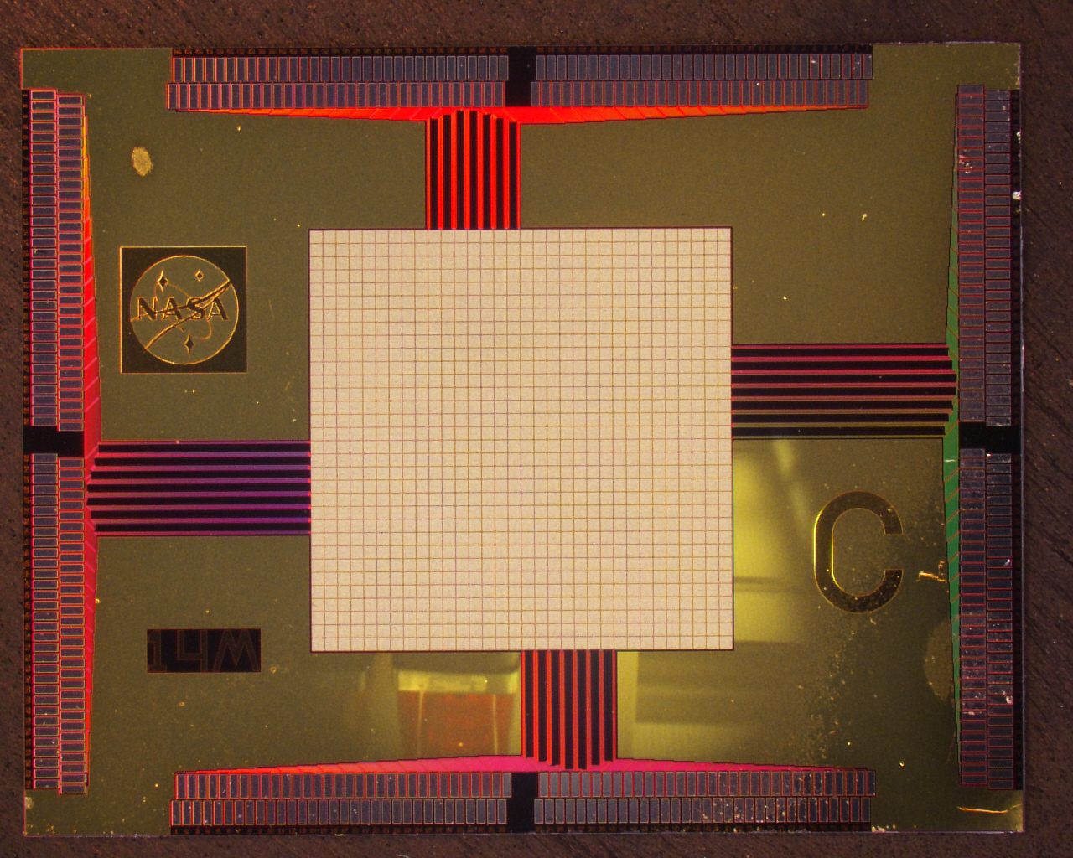
Demonstrating Enabling Technologies for the High-Resolution Imaging Spectrometer of the Next NASA X-ray Mission
PI: Caroline Kilbourne NASA/GSFC
Objectives and Key Challenges:
Developing large-format arrays of X-ray microcalorimeters & read-out, enabling next generation of high-resolution X-ray imaging spectrometers for astrophysics.
Advance TRL of the key components of an X-ray microcalorimeter imaging spectrometer from TRL-4 to TRL-5, and to advance a number of important related technologies to at least TRL-4.
Significance of Work:
Demonstrate multiplexed (3 columns x 32 rows) read-out of 96 different flight-like pixels on a 0.25 mm pitch in a 32x32 (or greater) array with > 95% of pixels achieving better than 3-eV resolution at 6 keV.
Energy resolution at 6 keV in 32 x 32 array with TDM multiplexed read-out of different numbers of rows.
Approach:
Mo/Au TES thermometers with close-packed Bi/ Au thermalizing x-ray absorbers on a 0.25 mm pitch. Time-division multiplexed read-out.
For point source array, fine-pitch (0.075 mm) pixels with Au absorbers.
Recent Accomplishments:
High-resolution spectroscopic capability demonstrated when reading out kilo-pixel array with two multiplexed columns from the array, each of which is multiplexing the read-out of 16 pixels (2/2014).
Increased speed of read-out amplifier and digital feedback electronics, close to fulfilling the target specifications (12/2014).
Key Collaborators:
Joel Ullom, Randy Doriese, Carl Reintsema – NIST
Kent Irwin – Stanford
Joseph Adams, Simon Bandler, Richard Kelley, Scott Porter, Stephen Smith - GSFC
Next Milestones:
Will demonstrate 3x32 multiplexed read-out of standard pixels, and also multiplexed read-out of Hydras and small-pitch pixels (3/2015 – 9/2015).
Current Funded Period of Performance:
October 1, 2012 – September 30, 2015
Program initially funded as 2-year program, rescheduled as 3-year program due to key participants’ involvement with Astro-H
Application:
Potential contribution to the X-ray Integral Field Unit Instrument on ATHENA (Advanced Telescope for High ENergy Astrophysics)
Japanese mission such as DIOS, or X-ray mission as follow-on to ASTRO-H.
TRLin = 4 TRLcurrent est. by PI = 4.5 TRLtarget = 5

Slide 44
Colloid Microthruster Propellant Feed System
PI: John Ziemer/JPL
Objectives and Key Challenges:
Replace the heavy (up to 15 kg) spring-loaded bellows design from ST7 with a light-weight pressurized diaphragm tank (≤1 kg)
O1: Design tank and feed system with full redundancy
O2: Design, fabricate, and test stainless steel diaphragm tank
Use the new Busek Microvalve (Phase II SBIR and Phase IIe) to reduce complexity while providing redundancy
O3: Design, fabricate, and test new Busek Microvalves
O4: Integrate and test feed system components to TRL 5
Significance of Work:
A new, flight-like, fully redundant, higher capacity colloid thruster feed system at TRL 5 can support any gravity wave observatory concept
A clear path to TRL 6 once the mission and system are defined
Approach:
Teaming arrangement between flight tank vendor Keystone, Busek for the Microvalve, and JPL to manage, perform I&T
Use standard liquid-fed propulsion flight design guidelines and practices – the new technology is in the assembled pieces working together, not the propulsion engineering approach
Four tasks related to each objective, plus a management task, each with a JPL expert lead
Hold peer reviews at each meaningful milestone: requirements definition, design, and test
Recent Accomplishments:
Tank fabrication and TRL 5 tests are complete
Microvalve fabrication and environmental tests are complete
Redundant Microvalve subassembly including accumulator and volume compensator has been fabricated and tested for TRL 5
Tank and supportive feed system components are all at JPL, ready for integration; data system complete
Next Milestones:
Receive Busek Microvalve subassembly and test full feed system assembly to TRL 5
Key Collaborators:
Busek Co., Inc. on Microvalve and systems engineering
Keystone Engineering on flight-like tank manufacture and test
JPL electric / chemical propulsion and flight propulsion groups
Application:
Drag-free gravity wave observatories
Remove reaction wheels - precision pointing of exo-planet observatory and next generation space telescopes
Small spacecraft main propulsion
Current Funded Period of Performance:
Jan 2013 – Jan 2015
TRLin = 3-4 TRLcurrent = 4 TRLtarget = 5

Slide 45
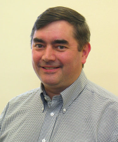
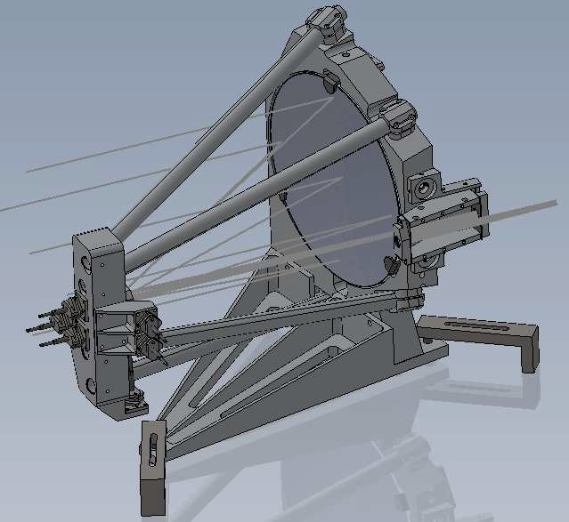
Telescope for a Space GW Mission
PI: Jeff Livas/GSFC
Objectives and Key Challenges:
Establish a complete telescope design meeting optical, mechanical, thermal, and manufacturability NGO requirements for US contribution to L2 mission
Fabricate and test a prototype
Off-axis Design Prototype in Process
M1
Significance of Work:
Conflicting requirements:
On-axis design more stable for thermal environment but higher scatter
Off-axis design lower scatter but more difficult to build (hence expensive)
Can an on-axis design meet requirements? Or
Can an off-axis design be manufactured? YES
M2
M3 & M4
Approach:
Use SGO-Mid reference and the ESA eLISA
“Yellow Book” to generate requirements
L3/SSG for basic design (off-axis SiC recommended)
Fabricate a prototype from the design
Verify for compliance with specifications
Concentrate on stray light model validation
Recent Accomplishments and Next Milestones:
Nov 2013: Telescope RFP terminated: no award
Dec 2013: Simplified telescope model
Apr 2014: Telescope mirror specs completed
Jun 2014: Prototype model contract signed
Oct 2014: Prototype CDR
Mar 2014: Prototype Telescope delivery to GSFC
Apr 2014: Prototype Telescope aligned
Sep 2015: System-level scattered light model validated
Key Collaborators:
Code 551: Joe Howard/Garrett West/Peter Blake/Len Seals/Ron Shiri/
Code 543: John Crow/Justin Ward
Application:
Flagship gravitational wave missions (eLISA)
Laser ranging; precision metrology applications
Laser communications
Current Funded Period of Performance:
Oct 2012 – Sept 2014
Oct 2014 – Sept 2015 no cost extension
TRLin = 3 TRLcurrent est. by PI = 3 TRLtarget = 3+

Slide 46
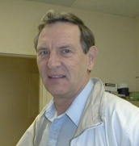
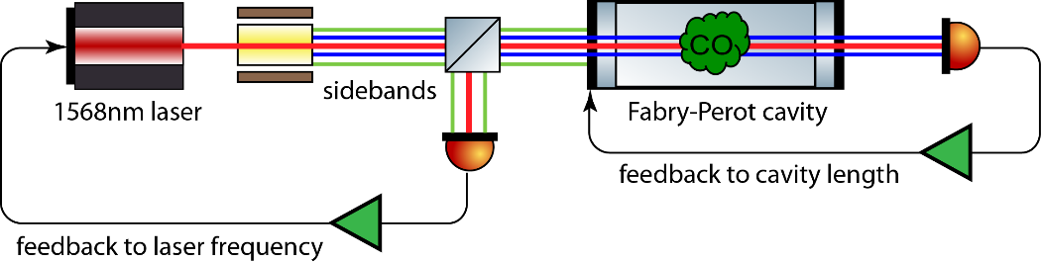
Laser Stabilization with CO
PI: John Lipa/Stanford University
Objectives and Key Challenges:
• Develop a laser operating near 1570 nm with improved noise performance and mid-term frequency stability, for missions that could use a highly coherent light source near the telecom band.
• Performance goals are to achieve substantially lower noise than Iodine-stabilized lasers, the current gold standard for transportable systems. Goal is to achieve an Allan deviation of ~ 2x10⁻¹⁵ in a one second measurement time.
Challenge: Noise performance and frequency stability of lasers on short and intermediate time scales: requires dual locking scheme shown on right.
Dual sideband laser locking optics
Significance of Work:
A highly stable laser simultaneously locked to a cavity and a molecular transition at a Telecom wavelength.
Approach:
Set up a bench-top model of laser system for CO based on existing system at JILA for C2HD near 1064 nm
Perform functional tests on system
Set up a system to allow detailed noise performance measurements
Upgrade optics and electronics to achieve noise performance goal
Recent Accomplishments:
Laser stabilization system fully functional 6/14
First ever CO stabilized laser 9/14
Initial noise measurement 11/14
Key Collaborators:
Jan Hall, JILA
Bob Byer, Sasha Buchman, Stanford
Shailendhar Saraf, SN&N Electronics, CA
Next Milestones:
Noise measurements using frequency comb 1/15
Noise measurements with reference cavity 3/15
Documentation of final TRL 5/15
Application:
Applications would be tests of fundamental physics, gravity wave observation, precision spectroscopy and Doppler, formation flying, trace gas detection.
Current Funded Period of Performance:
Jan 2013 – Dec 2014 (no-cost extension to 6/15)
TRL _{In} = 3 TRL _{PI-Asserted} = 3+ TRL _{Target}= 4

Slide 47



Planar Antenna-Coupled Superconducting Detectors for CMB Polarimetry
PI: James Bock/JPL
Objectives and Key Challenges:
Advance antenna-coupled superconducting detector technologies for space requirements:
Antenna design and performance
Propagation losses
Develop and test modular focal plane units
MKIDs for CMB science
TES stability & cosmic-ray response
Extended-frequency antennas
Readout noise stability
Sub-orbital focal plane array
Antenna-coupled TES
Significance of Work:
RF propagation properties of antennas
Detector sensitivity, stability, and minimized particle susceptibility
Approach:
Planar antennas provide entirely lithographed fabrication with no coupling optics
Design scales to all bands required for Inflation Probe from 30 to 300 GHz
Detectors provide photon-limited sensitivities in space
Antennas provide excellent polarization and beam-matching properties
Modular focal-plane unit for large focal plane arrays
Recent Accomplishments:
Tested sample of far-field beams of tapered antennas
220 GHz focal planes developed and characterized
Optimized magnetic shielding of 95 GHz focal plane module
Characterized loss and coupling at 250 GHz
Next Milestones:
Flight of SPIDER for particle response demonstration (Jan 2015)
Full test of far-field beams of tapered antennas (Mar 2015)
40 GHz antenna design (Feb 2015)
Beam-tests of module in representative optics (April 2015, delayed)
Key Collaborators:
Koko Megerian, Hien Nguyen, Roger O’Brient, Anthony Turner, Alexis Weber (JPL)
Jeff Filippini, Sunil Golwala, Howard Hui , Zak Staniszewski (Caltech)
Chao-Lin Kuo (Stanford)
Applications:
NASA Inflation Probe mission
Explorer & international CMB missions
Technology commonalities with Far-IR and X-Ray missions
Current Funded Period of Performance:
October 2013 – September 2015
TRL _{In} = 3-4 TRL _{PI-Asserted} = 3-5 TRL _{Target}= 4-6

Slide 48


Demonstration of a TRL 5 Laser System for eLISA
PI: Jordan Camp / GSFC
Objectives and Key Challenges:
Develop 1.5W light source for the eLISA gravitational wave mission using a Master Oscillator Power Amplifier design with a novel diode laser oscillator (External Cavity Laser, ECL) followed by a 1.5W Yb fiber amplifier, providing a highly stable, compact, and reliable system
Test the laser system for reliability, and for amplitude and frequency stability, achieving the required noise performance
Demonstrate system TRL 5
Significance of Work:
Development, with industrial partner (Redfern Integrated Optics), of space qualified, ultra low-noise oscillator
Demonstration of low-noise power amplifier with servo controls
Noise and reliability tests of full laser system
Master Oscillator / Power Amplifier (MOPA) configuration of eLISA laser, including ECL, preamp, and diode pumped Ytterbium (Yb) fiber amplifier
Approach:
Noise optimization of 1064 nm External Cavity Laser (RIO)
Reliability study of External Cavity Laser
Implementation of amplitude and frequency servo controls on full laser system, achieving RIN=10⁻⁴ at 10⁻³ Hz, frequency noise = 300 Hz / Hz^{1/2} at 10⁻² Hz, and differential phase noise = 6x10⁻⁴ rad/Hz^{1/2} at 10⁻² Hz
Recent Accomplishments and Next Milestones:
Developed and constructed 1.5 W laser amplifier
Fabricated world’s first butterfly package layout 1064 nm ECL
Rebuild and test 1.5 W laser amplifier (Aug 2014)
Preliminary laser system test with NPRO (Dec 2014)
Noise optimization of ECL optical cavity (Dec 2014)
Preliminary laser system test with ECL (Mar 2015)
Noise optimization of ECL gain chip (Jun 2015)
ECL reliability tests (Aug 2015)
Full laser system noise testing (Jan 2016)
Full laser system reliability testing (Mar 2016)
Key Collaborators:
Kenj Numata, Mike Krainak (NASA/GSFC)
Lew Stolpner (Redfern Integrated Optics)
Current Funded Period of Performance:
April 2014 – April 2016
Applications:
Laser source for eLISA Gravitational Wave mission
Oscillator for ground-based GW LIGO project
Oscillator for GRACE-II mission
TRL _{In} = 3 TRL _{Current} = 3 TRL _{Target}= 5

Slide 49

Gravitational-Wave Mission Phasemeter Technology Development
PI: William Klipstein, JPL
Objectives and Key Challenges:
Advance technology readiness level (TRL) of phase-measurement electronics and demonstrate performance in upgraded interferometer-system-level test-bed providing signals representative of gravitational-wave missions, such as the Laser Interferometer Space Antenna (LISA)
Significance of Work:
High-strain sensitivity requires micro-cycle/Hz^{1/2} precision on a 4-18 MHz beat-note in the presence of laser frequency noise and local clock noise
We have demonstrated such phase readout in an interferometer test-bed and plan to mature the technology
Modified test-bed for end-to-end testing to advance system-level TRL of phase measurement system
Approach:
Advance component technologies
Advance maturity of analog signal chain
Demonstrate wave-front sensing with quadrant photo-receivers
Complete design trade for reducing photo-receiver size
System-level testing
Modify interferometer test-bed to include low-light signals
Replace COTS components in interferometer test-bed with higher-TRL units and demonstrate performance
Recent Accomplishments:
Design 2nd generation analog signal chain (Nov 2014)
Next Milestones:
Build 2nd generation analog signal chain (Feb 2015)
Demonstrate wave-front sensing (Sep 2015)
Implement quadrant photo-receivers in existing test-bed (Dec 2015)
Applications:
Inter-spacecraft laser interferometry
Interferometer readout electronics with picometer precision
Future space mission, e.g., LISA
Capability supports other interferometry concepts (e.g., exo-planet finding)
Key Collaborators:
Jeff Dickson, Brent Ware, Bob Spero, Kirk McKenzie, Glenn de Vine, Andrew Sutton (JPL)
Current Funded Period of Performance:
April 2014 – March 2016
TRL _{In} = 4 TRL _{Current} = 4 TRL _{Target}= 5

Slide 50


Development of Fabrication Process for Critical-Angle X-ray Transmission Gratings
PI: Mark Schattenburg/MIT MKI
Objectives and Key Challenges:
Develop key technology to enable a Critical-Angle X-ray Transmission Grating Spectrometer (CATGS), advancing to TRL-6 in preparation for proposed missions or Explorers over the next two decades
Develop improved grating fabrication processes and procure advanced etching tool and other infrastructure in order to accelerate technology development
Significance of Work:
Development of nanofabrication technology for the silicon nanomirror grating elements
Development of microfabrication processes for the integrated grating support mesh
Approach:
Integrated wafer front/back-side fabrication process using silicon-on-insulator (SOI) wafers
Wafer front side: CAT grating structure + Level 1 support
Wafer back side: Level 2 support hex-mesh structure
CAT grating fabricated by deep reactive ion-etching (DRIE) followed by KOH polishing
Bonded to expansion-matched metal support frame (Level 3 support)
X-ray testing of prototypes at synchrotrons and MSFC facility
Recent Accomplishments and Next Milestones:
Developed improved DRIE process with significantly reduced line bowing. Developed improved backside etch process.
Demonstrated KOH polish to full 4.0 μm depth following DRIE.
Demonstrated fully-integrated 31x31 mm² grating with KOH polish.
Developed novel process to produce stress-controlled SOI wafers.
Acquired and installed new DRIE tool (SPTS Pegasus) in SNL.
Transferred process to new tool and demonstrated excellent etch profile control.
Fabricated CAT gratings with record soft x-ray diffraction efficiency.
Key Collaborators:
William Zhang (GSFC)
Steve O’Dell (MSFC)
Application:
Flagship, Probe and Explorer class x-ray astronomy missions requiring high resolution spectroscopy
Laboratory x-ray analysis (materials science, energy research)
Current Funded Period of Performance:
1/1/15 – 12/31/16
TRLin = 3 TRLcurrent = 3 TRLtarget = 6

Slide 51




Adjustable X-Ray Optics with Sub-Arcsecond Imaging
PI: Paul Reid/SAO
Objectives and Key Challenges:
Develop adjustable light weight x-ray optics with sub arcsecond performance
Create the enabling optics technology for a large aperture high resolution x-ray mission (SMART-X) for selection at the next Decadal Survey
Adjustable mirror with strain gauges on every cell
Significance of Work:
Sub-arcsecond optics fabricated with traditional methods are too heavy; light, thin replicated optics performance is limited to ~7”
By coating thin glass optics with piezoelectric material, whose shape can be altered by applying a voltage, we can correct unwanted figure distortions improving performance to <1”
Mirror pair during alignment
Figure change from three non-adjacent piezo cells energized simultaneously, measured with Shack-Hartmann wavefront sensor
Approach:
Deposit piezoelectric material (PZT) on conical thermally formed glass
Mount and align a piezo coated mirror pair
Correct unwanted figure distortions by adjusting the voltage applied to the piezo material
Prove out performance using x-ray testing
Recent Accomplishments:
Demonstrated predicable, repeatable deformations on cylindrical optics that matched values predicted by models
Completed mounting and aligning of mirror pair using first generation mount; starting mount design improvement phase
Deposited strain gauges on piezo cells
Calculated PZT life of > 1000 years from accelerated lifetime test results
Key Collaborators:
Susan Trolier Mckinstry (PSU)
Brian Ramsey and Stephen O’Dell (MSFC)
Next Milestones:
Mount / align improved conical optics in TRL-4 mount
Application:
Large aperture and high resolution x-ray mission for the 2020s (Square Meter Arcsecond Resolution X-ray Telescope, SMART-X)
Current Funded Period of Performance:
Feb 2013 – Jan 2016
TRLin = 2 TRLcurrent est. by PI = 3 TRLtarget = 4

Slide 52


Reflection Grating Modules: Alignment and Testing
PI: Randall McEntaffer/University of Iowa
Objectives and Key Challenges:
To increase the TRL of off-plane gratings
Align multiple gratings into flight-like modules
Performance test aligned gratings for spectral resolving power
Environmental test modules with performance verification
Significance of Work:
Enables future spectrometers to accomplish key soft X-ray science goals that require high sensitivity combined with high spectral resolving power
Upper left: Metrology system for grating alignment, Lower right: Grating module with pico actuators
Approach:
Leverage from previous SAT and supporting programs to supply gratings and preliminary designs
Align gratings into module using proven methods
Use Stray Light Facility at MSFC for performance and environmental testing
Recent Accomplishments:
Initial testing of prototype gratings has been accomplished
Alignment tolerances are known
Initial modules have been fabricated and tested
Next Milestones:
Test active and passive module mounts (Year 1)
Increase fidelity of module mount and alignment methodology (Year 1 – Year 2)
Test flight-like aligned module (Year 2)
Key Collaborators:
Jessica Gaskin, MSFC
Will Zhang, GSFC
Application:
Suborbital rocket missions - OGRE
Small Explorers - Arcus
Current Funded Period of Performance:
01/2015 – 12/2016
TRL _{In} = 3 TRL _{PI-Asserted} = 4 TRL _{Target}= 6

Slide 53



Next Generation X-ray Optics: High-Resolution, Lightweight, and Low-Cost
PI: William W. Zhang/GSFC
Objectives and Key Challenges:
Develop a lightweight X-ray mirror technology achieving better than 5” HPD angular resolution, advancing it to TRL 5, and readying it to enable missions planned for both 2010’s and 2020’s
Mature and perfect this technology to minimize cost and schedule
Prepare ways to achieve significantly better than 5” resolution while keeping mass and cost at similar levels
A Technology Development Module (TDM) containing three pairs of parabolic-hyperbolic mirror segments that has passed both performance and environmental test
X-ray PSF demonstrating 8 arcsec HPD
Significance of Work:
Fabrication and metrology of mirror segments
Alignment and bonding of mirror segments
Approach:
Make mirror substrates by slumping glass or polishing silicon
Maximize X-ray reflectance using magnetron sputter or atomic layer deposition
Measure performance using interferometer, null lens, and interferometric microscope
Align mirror segments using Hartmann tests
Develop precision epoxy bonding techniques
Recent Accomplishments:
Repeatedly co-aligned and bonded multiple mirror pairs, achieving 8” HPD X-ray Point Spread Function (PSF, see lego plot above)
Next Milestones:
Transition from using glass substrates to using single crystal silicon substrates by December 2015
Build and test technology development modules with silicon substrates and achieve 5” HPD by December 2016
Key Collaborators:
Michael Biskach, Kai-Wing Chan, Ryan McClelland, Timo Saha (NASA/GSFC)
Stephen O’Dell (NASA/MSFC)
Applications:
Backup technology for ESA’s Athena mission
Flagship and probe-class X-ray missions
Explorer-type X-ray missions
Sounding rocket and balloon experiments
Medical research and diagnosis
Current Funded Period of Performance:
October 2014 – September 2016
TRL _{In} = 3 TRL _{PI-Asserted} = 4 TRL _{Target}= 5

Slide 54


Fast Event Recognition for the ATHENA Wide Field Imager
PI: David Burrows / PSU
Objectives and Key Challenges:
High-speed event recognition and data compression
Significance of Work:
Required for future proposed X-ray imagers, including Athena WFI (ESA L2), JANUS XCAT (EX), XTiDE XCAT (SMEX), Arcus (ISS), X-ray Surveyor (Astrophysics Roadmap)
Approach:
FPGA coding/simulation/testing
Testing with fixed patterns up to 1GB/s
Testing with real X-ray data up to 1GB/s
Recent Accomplishments:
Initiated internal funding codes, ordered development kit
Key Collaborators:
Dr. Karl Reichard, Eli Hughes ( PSU/ARL )
Dr. Zach Prieskorn, Dr. Tyler Anderson ( PSU/ECOS )
Dr. Mark Bautz (MIT), Dr. Steve Murray (SAO)
Next Milestones:
Design Review, July 2015
Applications:
Including Athena WFI (ESA L2), JANUS XCAT (EX), XTiDE XCAT (SMEX), Arcus (ISS), X-ray Surveyor (Astrophysics Roadmap)…
Current Funded Period of Performance:
1/2015 – 12/2016
TRL _{In} = 3 TRL _{PI-Asserted} = 3 TRL _{Target}= 4

